Slide 1
Subnetting Exercise – 4
You are given an IP address 198.22.45.173/26.
What is the subnet mask in dotted decimal notation?
For this IP address, what are the network address, broadcast address, and valid host addresses?

Slide 2
Solution
Let us calculate the subnet mask
Default for class C is /24
So, /26 will mean 2 extra bits from the host it will be borrowed and used as subnet id
128 + 64 = 192
So the subnet mask will be 255.255.255.192

Slide 3
Solution - Subnets and Hosts
Our given address is 198.22.45.173/26
Since two bits are reserved for the subnet id, 4 subnets 00, 01, 10, and 11 are possible
We need to think “Our IP address will fall in which of these four subnets?”
To answer this, let us calculate the address range for each of the four subnets

Slide 4
Solution - Subnets and Hosts
Subnet Number (Decimal) | Subnet ID (Binary) | First full address in the subnet (Binary) | Last full address in the subnet (Binary) | First full address in the subnet (Decimal) | Last full address in the subnet (Decimal) | Our target IP address (173)
1 | 00 | 00000000 | 00111111 | 0 | 63 | Not here
2 | 01 | 01000000 | 01111111 | 64 | 127 | Not here
3 | 10 | 10000000 | 10111111 | 128 | 191 | Here
4 | 11 | 11000000 | 11111111 | 192 | 255 | Not here
Our given address is 198.22.45.173/26

Slide 5
Solution
Our target address is 198.22.45.173/26
Where does this address lie in the table? Answer: Third subnet
198.22.45.128 is the network address
So the broadcast address is 198.22.45.191
And the valid host addresses are 198.22.45.129 to 198.22.45.190

Slide 6
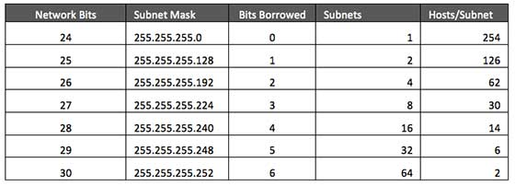
Summary: Subnetting in Class C

Slide 7
Variable Length Subnet Mask (VLSM)

Slide 8
VLSM Concept
Early routing protocols only supported Fixed Length Subnet Masking (FLSM) where all subnets had to be the same size.
You couldn’t have a subnet with 14 hosts and another subnet with 64 hosts in the same network.
All modern routing protocols support Variable Length Subnet Masking (VLSM).
This allows us to size subnets differently according to how many hosts they have.

Slide 9
VLSM Considerations
How many locations do we have in the network?
How many hosts are in each location?
What are the IP addressing requirements for each location? (Should different departments or types of host be in different subnets?)
What size is appropriate for each subnet? (Don’t waste addresses, but leave room for growth.)

Slide 10
VLSM Example
Suppose there is an administrator that has four departments to manage.
These are sales and purchase department with 120 computers, development department with 50 computers, accounts department with 26 computers and management department with 5 computers.
If the administrator has IP 192.168.1.0/24, how can department wise IPs be allocated?

Slide 11
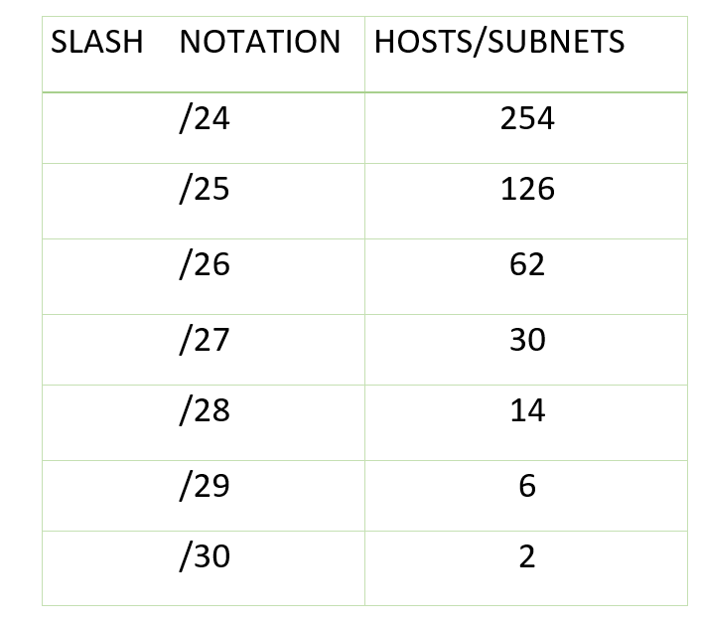
Variable Length Subnet Mask (VLSM)
Step 1: For each segment select the block size that is >= the actual requirement. Make a list of subnets possible:

Slide 12
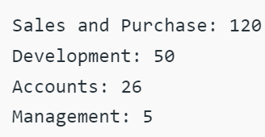
Variable Length Subnet Mask (VLSM)
Step 2: Arrange all the segments in descending order based on the block size that is from highest to lowest requirement:

Slide 13
Variable Length Subnet Mask (VLSM)
Step 3: The highest IP available has to be allocated to highest requirement, so the sales and purchase department gets 192.168.1.0/25, which has 126 valid addresses that can easily be available for 120 hosts. The subnet mask used is 255.255.255.128.
Network address: 192.168.1.0
Host range: 192.168.1.1 – 192.168.1.126
Broadcast address: 192.168.1.

Slide 14
Variable Length Subnet Mask (VLSM)
Step 4: The next segment (Development) requires an IP to handle 50 hosts. We need /26 for 62 hosts. The subnet mask used is 255.255.255.192.
Network address: 192.168.1.128
Host range: 192.168.1.129 – 192.168.1.190
Broadcast address: 192.168.1.191

Slide 15
Variable Length Subnet Mask (VLSM)
Step 5: Accounts needs 26 hosts. We will need /27, as it has 30 valid hosts. The mask used is 255.255.255.224.
Network address: 192.168.1.192
Host range: 192.168.1.193 – 193.168.1.222
Broadcast address: 192.168.1.223

Slide 16
Variable Length Subnet Mask (VLSM)
Step 6: The last segment (Management) requires 5 valid hosts IP, which means /29. Subnet mask is 255.255.255.248
Network address: 192.168.1.224
Host range: 192.168.1.225 to 192.168.1.230
Broadcast address: 192.168.1.231

Slide 17
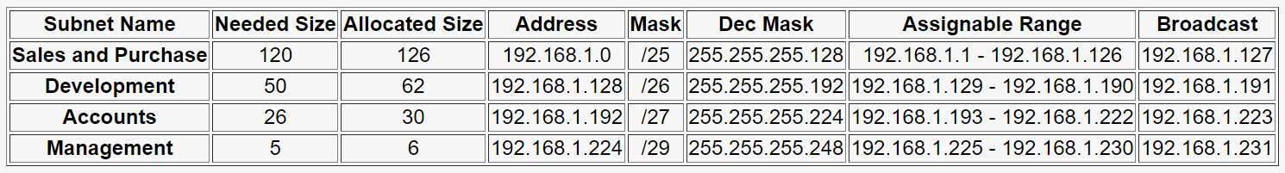
Summary

Slide 18
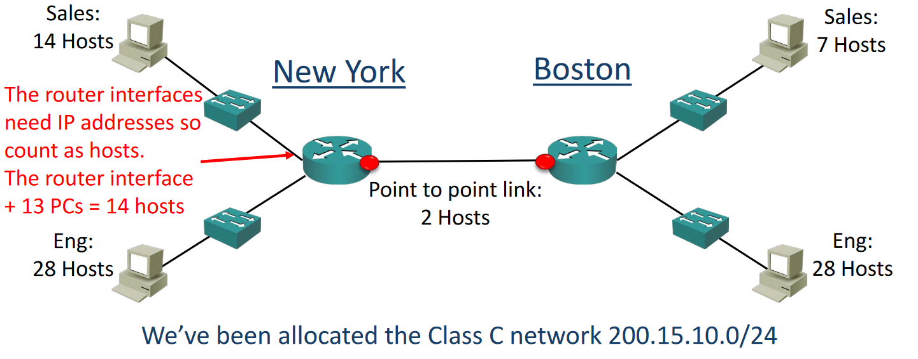
VLSM Example

Slide 19
VLSM Example – Design Steps
Find the largest segment and allocate a suitable subnet size for it.
Allocate this subnet at the start of the address space.
Continue going down the list.

Slide 20
VLSM Example – Design Steps
The Engineering departments in both sites have 28 hosts.
For our example we’ve been told that the departments will not grow and we need to use the smallest subnets possible to maximise our address space.
Calculate the optimal subnet mask for the Engineering departments.
Also determine the network and broadcast addresses that will be allocated to both Engineering departments, and the range of host addresses.

Slide 21
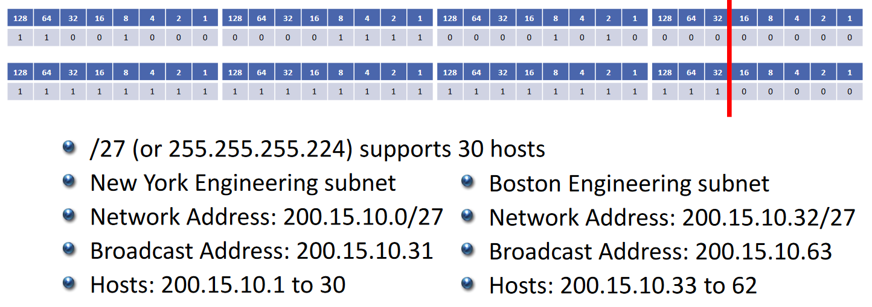
Engineering Departments
We’ve been allocated 200.15.10.0/24

Slide 22
New York Sales Department
The next largest subnet is New York Sales which requires 14 hosts.
Calculate the optimal subnet mask.
Also determine the network and broadcast addresses that we will allocate, and the range of host addresses.

Slide 23
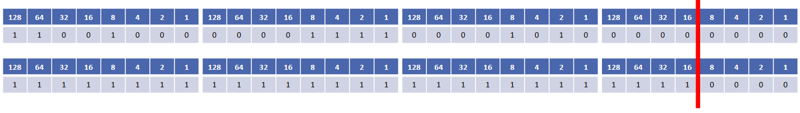
New York Sales Department
We’ve been allocated 200.15.10.0/24
New York Sales Department
We’ve been allocated 200.15.10.0/24
/28 (or 255.255.255.240) supports 14 hosts
200.15.10.0 to 200.15.10.63 are already in use by the Engineering departments, so this network address will start at 200.15.10.64
The network address goes up in values of 16, so the next one is 200.15.10.80
Our broadcast address is 200.15.10.79
Valid host addresses are 200.15.10.65 to 200.15.10.78

Slide 24
Boston Sales Department
The next largest subnet is Boston Sales which requires 7 hosts.
Calculate the optimal subnet mask.
Also determine the network and broadcast addresses that we will allocate, and the range of host addresses.

Slide 25
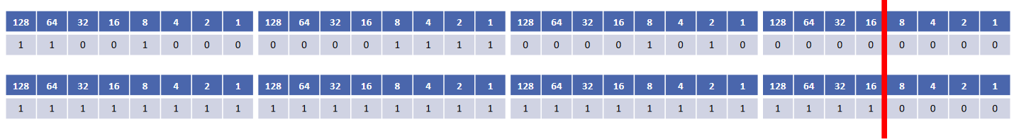
Boston Sales Department
We’ve been allocated 200.15.10.0/24
/28 (or 255.255.255.240) supports 14 hosts
/29 does not support 8 hosts! Remember to subtract 2 for the network and broadcast address
200.15.10.0 to 200.15.10.79 are already in use, so this network address will start at 200.15.10.80
The network address goes up in values of 16, so the next one is 200.15.10.96
Our broadcast address is 200.15.10.95
Valid host addresses are 200.15.10.81 to 200.15.10.94

Slide 26
Are we done?
Don’t forget the links between routers

Slide 27
New York to Boston Link
The last subnet is the link between the New York and Boston routers.
Calculate the optimal subnet mask.
Also determine the network and broadcast addresses that we will allocate, and the range of host addresses.

Slide 28
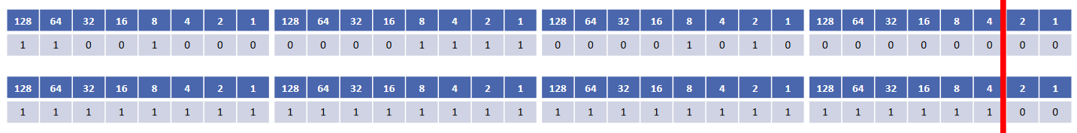
New York to Boston Link
We’ve been allocated 200.15.10.0/24
/30 (or 255.255.255.252) supports 2 hosts
200.15.10.0 to 200.15.10.95 are already in use, so our network address will be 200.15.10.96
The network address goes up in values of 4, so the next one is 200.15.10.100
Our broadcast address is 200.15.10.99
Valid host addresses are 200.15.10.97 to 200.15.10.98

Slide 29
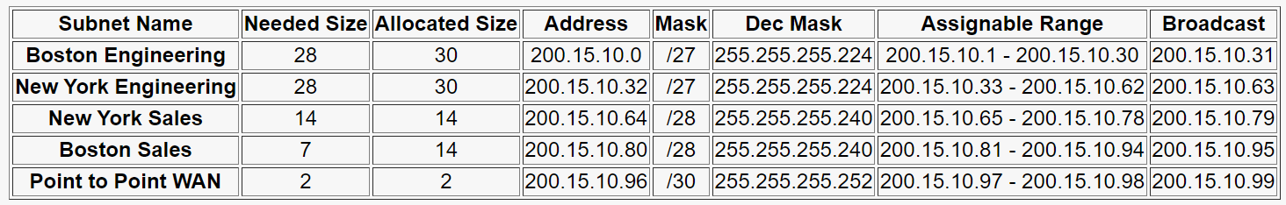
Summary

Slide 30
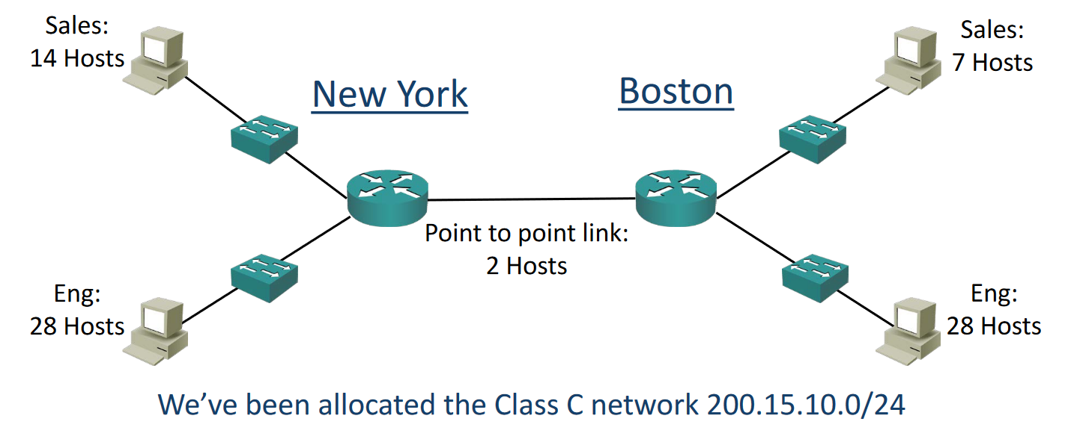
Original Network Diagram

Slide 31
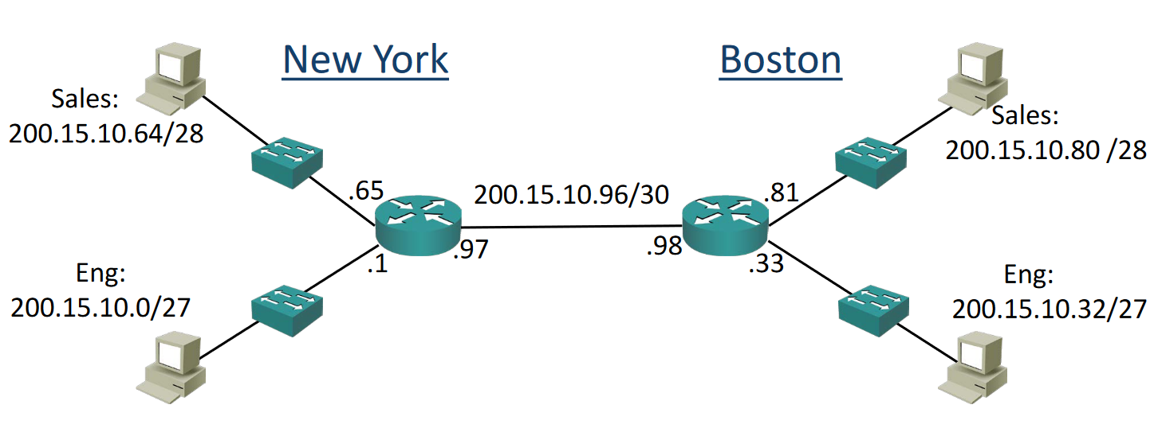
Diagram with Network Topology

Slide 32
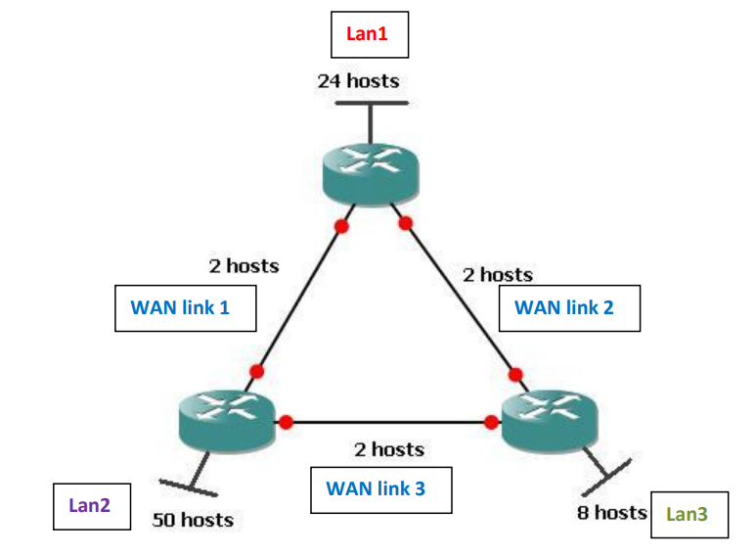
VLSM Problem
Create VLSM
IP address: 205.15.43.0/24

Slide 33
Solution
We have 6 networks: LAN1 – LAN2 – LAN3 – WAN link1 – WAN link2 – WAN link3
Order the networks from the largest size to the smallest:
1) LAN2 (50 hosts)
2) LAN1 (24 hosts)
3) LAN3 (8 hosts)
4) WAN link 1 - WAN link 2 - WAN link 3 (2 hosts each)

Slide 34
LAN2
Needs 50 hosts, so we will need to use /26 (will give 62 hosts)
Subnet mask: 255.255.255.192
Network address: 205.15.43.0
Host range: 205.15.43.1 - 205.15.43.62
Broadcast address: 205.15.43.63

Slide 35
LAN1
Needs 24 hosts, so we will need to use /27 (will give 30 hosts)
Subnet mask: 255.255.255.224
Network address: 205.15.43.64
Host range: 205.15.43.65 - 205.15.43.94
Broadcast address: 205.15.43.95

Slide 36
LAN3
Needs 8 hosts, so we will need to use /28 (will give 14 hosts)
Subnet mask: 255.255.255.240
Network address: 205.15.43.96
Host range: 205.15.43.97 - 205.15.43.110
Broadcast address: 205.15.43.111

Slide 37
WAN Link1
Needs 2 hosts, so we will need to use /30 (will give 2 hosts)
Subnet mask: 255.255.255.252
Network address: 205.15.43.112
Host range: 205.15.43.113 - 205.15.43.114
Broadcast address: 205.15.43.115

Slide 38
WAN Link2
Needs 2 hosts, so we will need to use /30 (will give 2 hosts)
Subnet mask: 255.255.255.252
Network address: 205.15.43.116
Host range: 205.15.43.117 - 205.15.43.118
Broadcast address: 205.15.43.119

Slide 39
WAN Link3
Needs 2 hosts, so we will need to use /30 (will give 2 hosts)
Subnet mask: 255.255.255.252
Network address: 205.15.43.120
Host range: 205.15.43.121 - 205.15.43.122
Broadcast address: 205.15.43.123

Slide 40
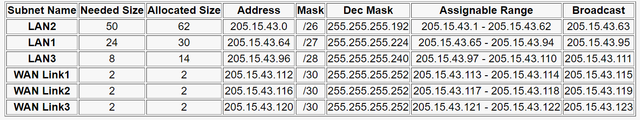
Summary

